Slide 1

Inventing Factors Affecting Serum Protein Electrophoresis Patterns
Seminar Presentation
Reyhaneh Seyfoury
Medical University of Kurdistan
Doctoral advisor: Dr.Rezgar Rahbari
Date: 2025/10/08

Slide 2
Seasons
01
Introduction
02
Technical Factors
03
Biological & physiological Factors
04
Pathological Factors
05
References

Slide 3
Introduction

Slide 4

Introduction
Electrophoresis is a laboratory technique used to separate proteins or molecules based on their electric charge and size. Samples are loaded onto a gel or suitable medium, and an electric current is applied, causing the proteins to move toward the opposite charge. The movement speed of each protein depends on its charge and size, and after separation, proteins can be stained and identified.

Slide 5
Types of serum protein electrophoresis
Cellulose Acetate / Agarose Gel Electrophoresis
Capillary electrophoresis
Immunofixation
Immunosubtraction
SDS-PAGE

Slide 6
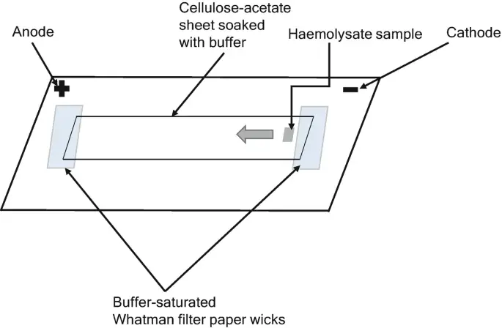
Cellulose Acetate Electrophoresis (CAE)
CAE is a method used to separate serum proteins or hemoglobins based on their charge and size using a cellulose acetate membrane.
Principle: Proteins migrate across the membrane under an electric field. Their movement depends on their net-charge at the buffer pH.
Medium: A thin strip of cellulose acetate acts as the support.
Applications:
Serum protein electrophoresis (SPEP)
Hemoglobin variant analysis
Advantages:
Quick and inexpensive
Easy staining and densitometry.
Limitations:
Lower resolution compared to gel-based methods
Limited ability to separate closely related proteins

Slide 7
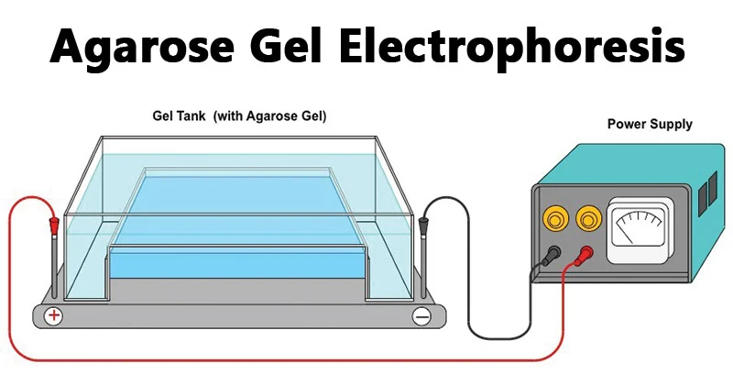
Agarose Gel Electrophoresis (AGE)
AGE is a widely used technique for separating macromolecules like DNA, RNA, or proteins in a gel matrix.
Principle: molecules migrate through a porous agarose gel under an electric field. Separation is based on size and charge.
Medium: Agarose gel
Applications:
DNA/RNA fragment analysis
Serum protein electrophoresis
Lipoprotein profiling
Advantages:
High resolution
Suitable for large molecules
Can visualize bands with UV or staining
Limitations:
Longer run time than CAE
Requires gel casting and buffer preparation

Slide 8
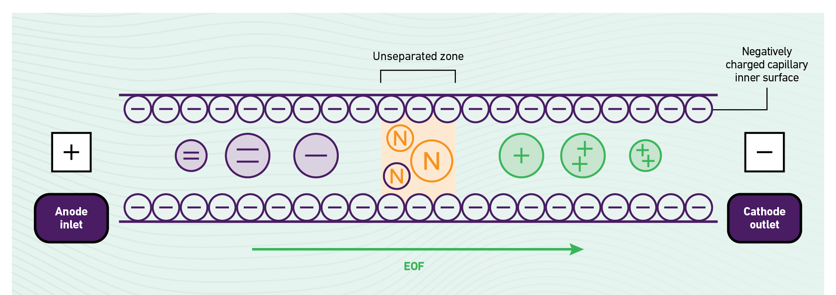
Capillary Electrophoresis
Capillary electrophoresis separates charged molecules based on their electrophoretic mobility in a narrow capillary tube filled with buffer.
Applications:
Clinical biochemistry: Serum protein analysis, hemoglobin variants
Pharmaceuticals: Drug purity and stability
Forensics: DNA profiling
Food industry: Additive and contaminant detection
Advantages:
High resolution and efficiency
Minimal sample volume required
Fast analysis time
Compatible with automated systems
Can be coupled with mass spectrometry for enhanced detection
Limitations:
Requires specialized equipment
Sensitivity depends on detection method
Buffer and capillary conditions must be precisely controlled

Slide 9
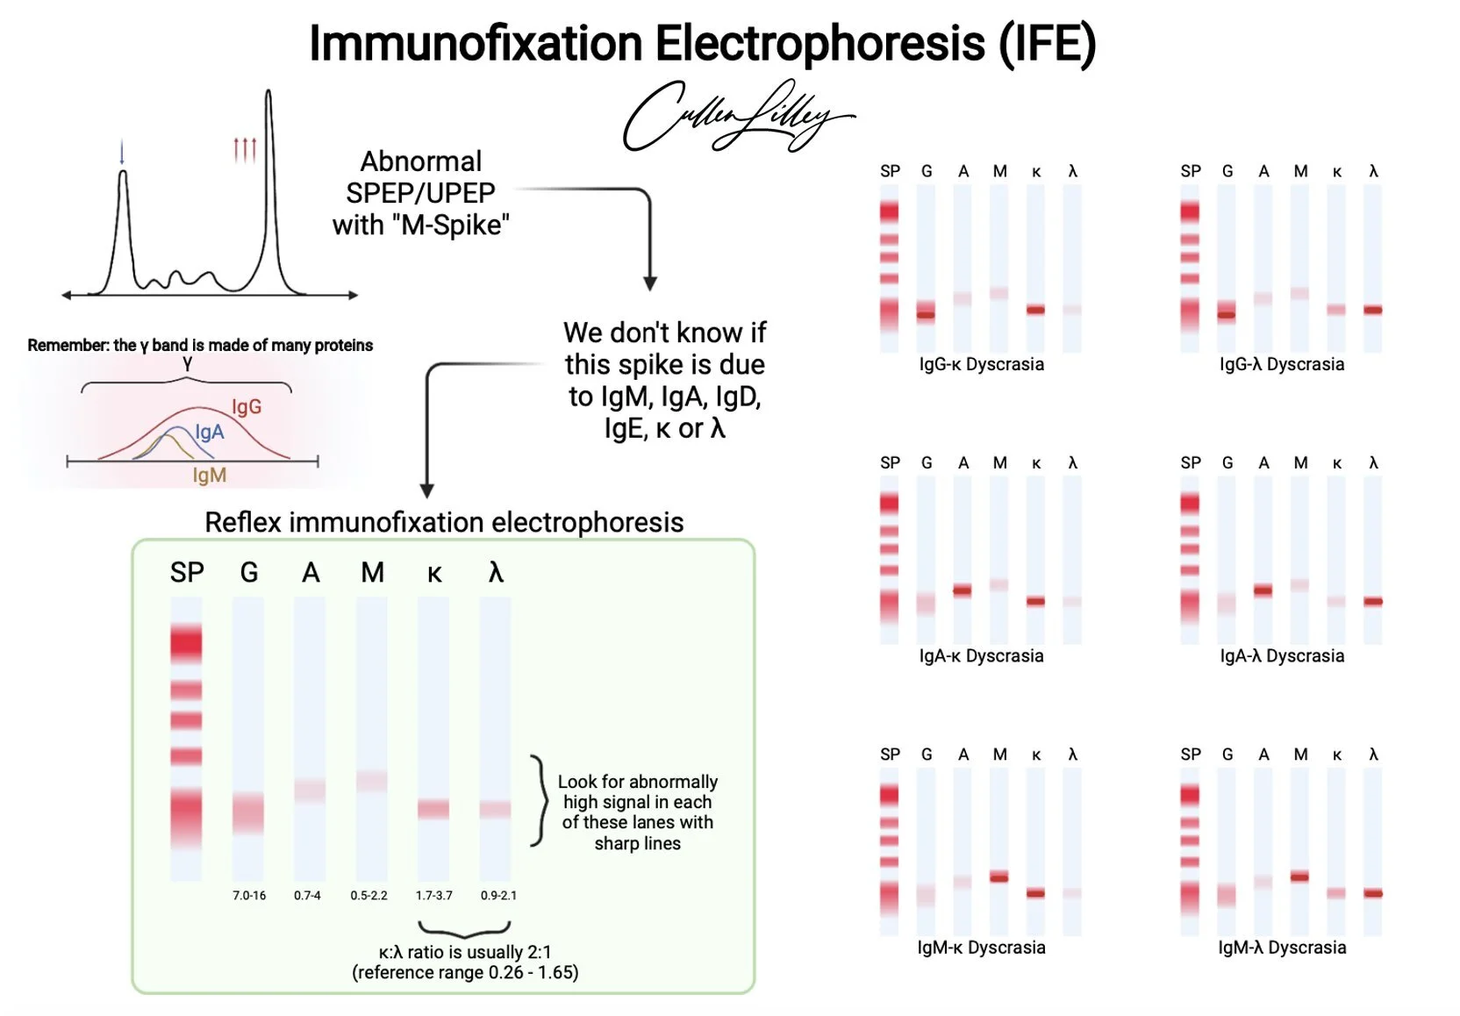
Immunofixation
Immunofixation is a two-step technique used to identify and characterize monoclonal immunoglobulins (M-proteins) in serum, urine, or cerebrospinal fluid. Electrophoresis and Immunoprecipitation
Applications:
Diagnosis of monoclonal gammopathies
Characterization of abnormal bands seen in serum protein electrophoresis (SPEP)
Monitoring treatment response in plasma cell disorders
Advantages:
High specificity for immunoglobulin types
Can detect low concentrations of monoclonal proteins
Differentiates between polyclonal and monoclonal patterns
Useful in clinical decision-making
Limitations:
Requires expert interpretation
Not quantitative—only qualitative
May miss very low-level monoclonal proteins if not properly concentrated

Slide 10
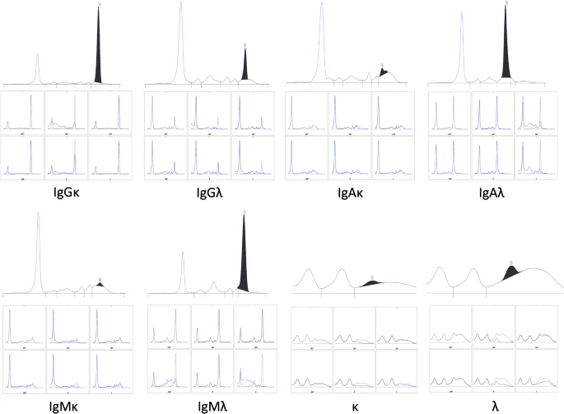
Immunosubtraction
Immunosubtraction is a modification of capillary electrophoresis used to identify monoclonal immunoglobulins by selectively removing them from the sample using specific antisera.
Applications:
Diagnosis of monoclonal gammopathies
Characterization of abnormal peaks seen in capillary electrophoresis
Monitoring disease progression and treatment response
Advantages:
High specificity and automation
Fast and reproducible
Can be integrated into capillary electrophoresis platforms
Requires small sample volume
Limitations:
Only detects immunoglobulin-related abnormalities
Requires high-quality antisera
May miss non-immunoglobulin monoclonal proteins

Slide 11
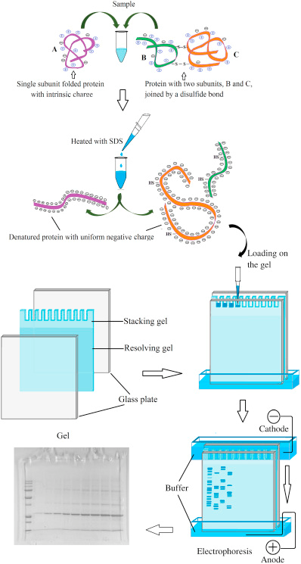
SDS-PAGE
SDS-PAGE separates proteins primarily based on their molecular weight just, not charge or shape.
Applications:
Protein size estimation
Purity assessment of protein samples
Monitoring protein expression in recombinant systems
Detection of post-translational modifications
Western blotting (SDS-PAGE is the first step)
Advantages:
High resolution for protein size separation
Widely used and standardized
Compatible with quantitative densitometry
Can resolve proteins from ~5 to 250 kDa
Limitations:
Cannot distinguish proteins of same size but different function
Denatures proteins—no information on native structure
Requires careful gel preparation and handling

Slide 12
Technique | Principle | Medium/Platform | Separation Basis | Applications | Advantages | Limitations
CAE | Charge-based migration | Cellulose acetate strip | Charge | Serum proteins, hemoglobins | Quick, inexpensive | Lower resolution
AGE | Size and charge-based migration | Agarose gel | Size and charge | DNA/RNA, serum protein, lipoproteins | High resolution, versatile | Longer run time
Capillary Electrophoresis (CE) | Electrophoretic mobility in capillary | Fused silica capillary | Charge and size | Serum protein, DNA, drugs, forensics | High resolution, fast, automatable | Requires specialized equipment
Immunofixation (IFE) | Electrophoresis + immunoprecipitation | Agarose gel | Charge + antibody binding | Monoclonal gammopathie, SPEP follow- up | High specificity, detects low levels | Qualitative only, expert interpretation
Immunosubtraction (ISUB) | Capillary electrophoresis + antisera | Capillary system | Disappearance of peak | Monoclonal gammopathie, CE peak ID | Automated, fast, specific | Only detects immunoglobulins
SDS-PAGE | Denatured proteins migrate by size | Polyacrylamide gel | Size only (uniform charge) | Protein size estimation, purity, Western blot | High resolution, standardized | Denatures proteins, no functional info

Slide 13
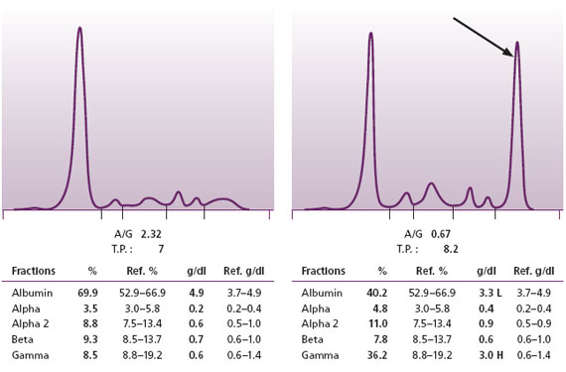
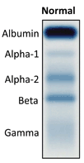
Normal SPEP and percents

Slide 14
Technical Factors

Slide 15
Technical Factors
Factor Category | Key Variables | Impact on SPE Results
Sample Quality | Hemolysis, lipemia, icterus | Band distortion, false peaks
Medium | Gel type, concentration, uniformity | Resolution and migration consistency
Buffer System | pH, ionic strength, temperature | Protein charge and migration speed
Voltage & Current | Voltage level, run time | Separation quality, overheating risk
Application Technique | Plasma,Sample volume, positioning | Band sharpness and symmetry
Staining & Visualization | Stain type, timing, destaining | Band visibility and contrast
Densitometry | Scanner, software, operator skill | Quantitative accuracy and interpretation

Slide 16
Biological & physiological Factors

Slide 17








Biological & physiological Factors
Age
Sex
Pregnancy
Nutritional
Hydration & dehydration
Stress or trauma
Practical Sports

Slide 18
Age and Gender
Newborns: Low gamma globulins due to immature immune system → flat gamma region.
Elderly: May show reduced albumin and mild poly-clonal gamma elevation due to chronic immune stimulation.
Generally minor differences:
Females may have slightly higher alpha-2 globulins due to hormonal influences.
Not typically diagnostic but may affect reference ranges.

Slide 19
Pregnancy & Nutritional
↑ Alpha-1 and alpha-2 globulins due to increased acute-phase proteins and hormonal changes.
↓ Alb due to hemodilution.
May mimic mild inflammatory pattern.
Kwashiorkor often shows dramatic albumin reduction due to impaired hepatic synthesis, leading to edema.
Marasmus shows generalized protein depletion but less severe hypoalbuminemia; no edema is present.
Kwashiorkor may also show beta-gamma bridging if liver dysfunction is present.

Slide 20
Hydration & dehydration /Stress or trauma
Apparent increase in albumin and globulin concentrations (false elevation).
Apparent decrease in protein fractions (false depression).
Triggers acute-phase response:
↑ Alpha-1 and alpha-2 globulins.
Transient changes that normalize with recovery.

Slide 21
Practical Sports
Protein Fraction | Change During Exercise | Cause | Interpretation Notes
Albumin | ↓ Slightly | Redistribution into tissues, mild hemodilution | May mimic mild hypo- albuminemia; reversible
Alpha-1 Globulin | ↑ Mildly | Acute-phase reactants (e.g., α1-antitrypsin) | Reflects transient inflammation
Alpha-2 Globulin | ↑ Mildly | Haptoglobin increase due to muscle stress/injury | May resemble mild inflammatory or stress response
Beta Globulin | ↑ Slightly | Transferrin and complement activation | Linked to repair and immune modulation
Gamma Globulin | ↔ or ↑ Slightly (in chronic training) | Repeated immune stimulation in endurance athletes | Polyclonal elevation; not pathological
Total Protein | ↔ or ↑ (in dehydration) | Hemoconcentration | Apparent increase; must assess hydration status

Slide 22
Pathological Factors

Slide 23
Pathological Factors
Monoclonal Gammopathies
Polyclonal Gammopathies
Nephrotic Syndrome
Acute and Chronic Response
Immunodeficiency

Slide 24
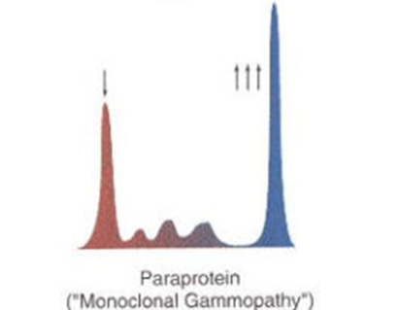
Monoclonal Gammopathies
Examples: Multiple myeloma, Waldenström’s macroglobulinemia, MGUS
SPEP Pattern: Sharp, narrow spike in the gamma region (M-protein)
Interpretation: Clonal proliferation of plasma cells producing identical immunoglobulin

Slide 25

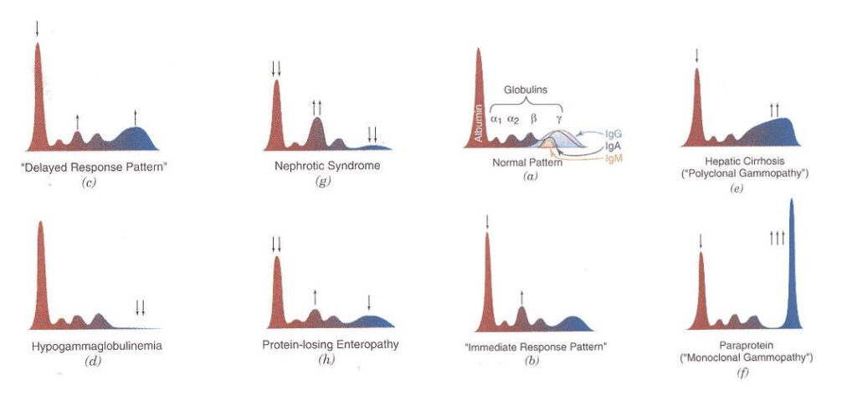
Polyclonal Gammopathies
Examples: Chronic infections, autoimmune diseases (e.g., lupus, rheumatoid arthritis)
SPEP Pattern: Broad-based elevation in gamma region
Interpretation: Diverse antibody production from multiple B-cell clones

Slide 26

Nephrotic Syndrome
SPEP Pattern: ↓ Albumin, ↑ Alpha-2 globulin
Interpretation: Loss of low-molecular-weight proteins in urine; retention of larger proteins

Slide 27
Acute and Chronic Response
Response Type | ↑ Positive Proteins | ↓ Negative Proteins
Acute | CRP, SAA, haptoglobin, fibrinogen, ferritin | Albumin, transferrin, transthyretin
Chronic | Mild ↑ CRP, SAA, fibrinogen, ↑ gamma globulins | Persistent ↓ albumin, transferrin

Slide 28
Immunodeficiency
Examples: Hypogammaglobulinemia, agammaglobulinemia
SPEP Pattern: ↓ or absent gamma region
Interpretation: Deficient antibody production

Slide 29
References

Slide 30
Tietz Textbook of Clinical Chemistry and Molecular Diagnostics
Henry's Clinical Diagnosis and Management by Laboratory Methods
The Blood Project – Serum Protein Electrophoresis
PathElective – SPEP and Immunofixation Interpretation
AMBOSS Medical Platform – Protein Analysis
American Academy of Family Physicians (AAFP) – SPEP Interpretation
International Myeloma Foundation – Monoclonal Protein Testing
BCIT Clinical Laboratory Science Resource
Medscape – Liver Disease and Electrophoresis

Slide 31
Thank you
Insert the title of your subtitle Here

